Slide 1
WSAA TOPIC 10 HOSTING
Database Connections:
pooling in mysql-connector
https://pynative.com/python-database-connection-pooling-with-mysql/
https://overiq.com/mysql-connector-python-101/connection-pooling-using-connector-python/
sqlalchemy
https://www.sqlalchemy.org/
https://blog.pythonanywhere.com/121/ (using sqlalchemy on pythonanywhere.com)

Slide 2
hosting a server on Python anywhere
Creating a python anywhere account
Creating a virtual environment
Using a GitHub repository to deploy a simple server.
Setting up a database and table on python anywhere.
Deploying a server that uses the database.
I did not need to install the modules on the requirements.txt file on python anywhere, because flask and mysql-connector come preinstalled
I did encounter am issues with the AJAX trying to access localhost instead of the app server on PythonAnywhere, I fixed this by making the URL relative instead of absolute (ie removed the host name)
There is of course more you can do to make your life easier.
have python code to setup database and table
have an if statement in the DAO so that it picks up the correct config file (no need to rename it then)

Slide 3


Slide 4
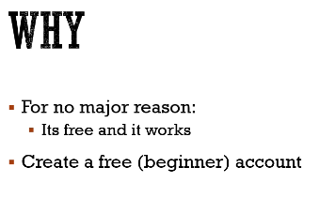
Why Pythonanywhere? https://www.pythonanywhere.com/

Slide 5
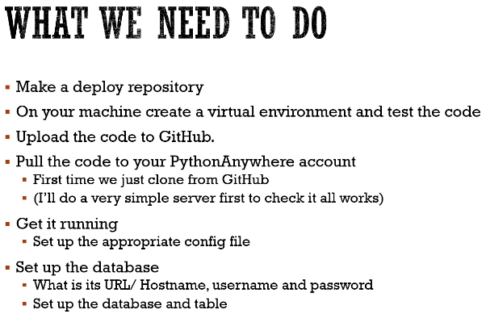

Slide 6
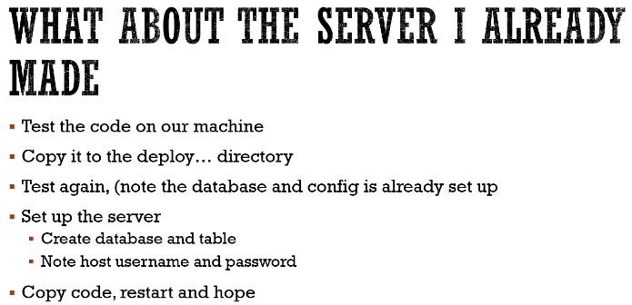

Slide 7
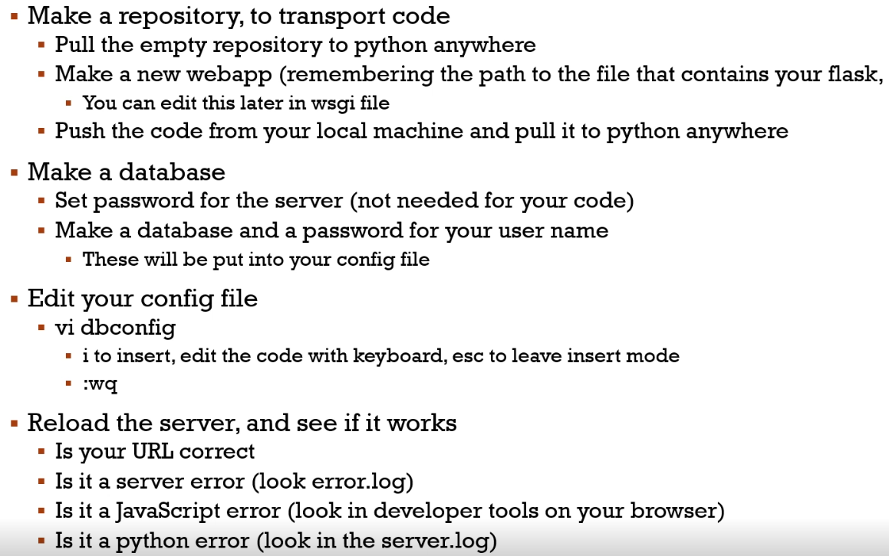

Slide 8
Old pythonanywhere

Slide 9
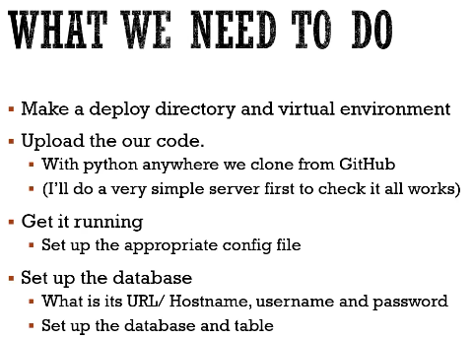

Slide 10
New repo on gh (deploytopa) and git clone
Simpleserver.py, save to deploytopa
Go into vm, check if runs in vm so we can make requirements.txt
On lappy: pip install virtualenv
python –m venv venv
.\venv\Scripts\activate.bat

Slide 11
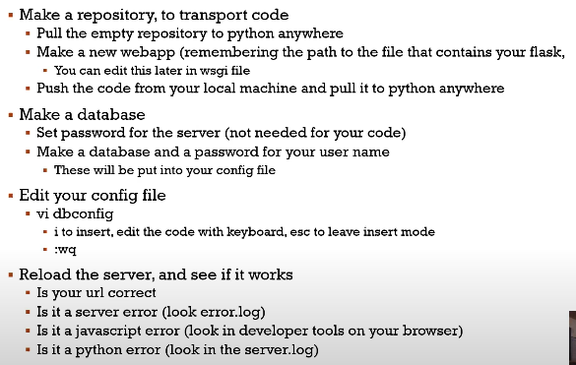

Slide 12


Slide 13
https://ws.cso.ie/public/api.restful/PxStat.Data.Cube_API.ReadDataset/HEO14/JSON-stat/2.0/en
(look at the raw data – horrible format)
5 labels
We want to put it into some kind of db like cso-formatted.json
Csodao.py goes through the data and turn it into the nice formatted json

Slide 14
Create table on mysql workbench csograds.mysql
show databases;
use wsaalab;
show tables;
create table grads(
year varchar(250),
field varchar(250),
nql_level varchar(250),
institution varchar(250),
num_of_grads int );
describe grads;

Slide 15
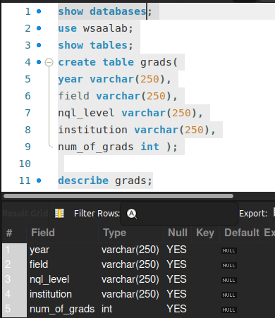

Slide 16
Dr11 – topic11-extra-csograd
Csodao.py <<<<<< run this
Rawdump.json
Graddao.py
Run csodao.py
Select * from grads; some error, I suspect from mysl password host etc

Slide 17
